Slide 1


AGILE DEVELOPMENT

Slide 2

Explaining agile Roles
Product Owner
Maximizes value of the product and work of the Development Team.
Scrum Master
Provides guidance in Agile principals
Is the servant-leader to the Product Owner.
Facilitates Scrum events.
Development Team
Consisting of Developers and Testers
Self-organized
Cross-functional

Slide 3
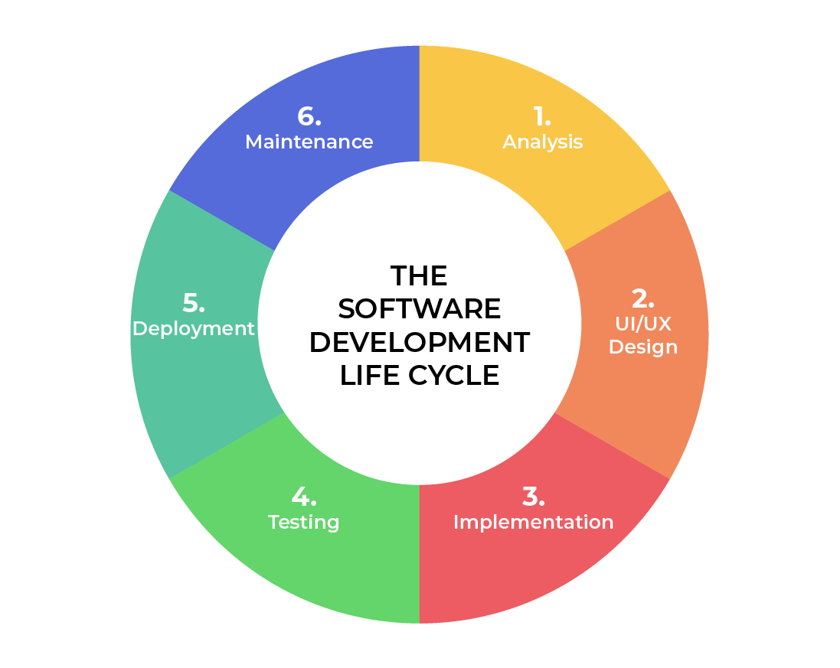
SOFTWARE DEVELOPMENT LIFECYCLE
Analysis
Collaborate with stakeholders.
Gather Requirements.
Design
Define detailed process for functionality.
Define technologies, limitations, time frames and budget.
Implementation
Development begins.
Functionality is broken up into smaller increments.
Testing
Occurs In conjunction with Development.
Process for identifying and mitigating reported defects and issue tracking.
Deployment
Testing complete and product is released to market.
Maintenance
Product in production environment.
Developers must be ready to implement NEW features and bug fixes as they come up.
Notes:
Analysis – This is the basic building block of the software development lifecycle. This is where leadership collaborates with various stakeholders to collect the requirements of the project.
Design – In this phase, the functionality is defined in detail. The technologies used and project resources, limitations, time frames and budgets are also discussed.
Development – In this phase, the development begins. The programming language used is dependent on the project. This is the longest phase in the SDLC because each functionality is broken into smaller increments to allow for value-based code development.
Testing – In conjunction with development, testing is also a common activity. Happens at all phases but specifically reserved for defects and issue tracking with existing code base.
Deployment – In this stage, testing is complete, and the product is ready to be deployed to market. UAT (User Acceptance Testing) may be performed in a limited environment before releasing to market.
Maintenance – In this stage, the product has been deployed into market. Developers must be ready and able to address any new features and bug fixes that users request and experience in production.

Slide 4

vs
No need to define all requirements.
Major requirements can be defined but functionality can evolve over time.
No time to market constraint
All requirements must be defined.
Contract Negotiation.
Sequential/Linear stages.
Best for simple, unchanging projects
Notes:
The SNHU Travel project would have been difficult to complete under a waterfall approach. Given the amount of uncertainty any changes would have had a negative impact on the project. Even with the high level of uncertainty with agile, any issues discovered would require a change order to the agreement which can be costly.

Slide 5
References
Charles G. Cobb. (2015). The Project Manager’s Guide
to Mastering Agile : Principles and Practices for an Adaptive Approach. Wiley. Software Development Life Cycle (SDLC). (2021). Retrieved October 2025, from
linkedin.com: https://www.linkedin.com/pulse/software-development-life-
cycle-sdlc-tutorial-richard-harris/

Slide 6
THANK YOU

